Slide 1
Away from home
UNIT 5A

Slide 2

Agenda
Review: Present simple tense
Vocabulary: Travel
British vs. American
Likes /Dislikes
Reading: Holiday home advertisements

Slide 3

Learning objectives
The student will be able to know more about travel and living experiences.
The student will be able to learn about likes and dislikes.
The student will be able to communicate short and concrete ideas.

Slide 4
Silent letters
Romantically
Thumb
Dumb
Doubt
Logically

Slide 5
Silent letters
Muscle
Sandwich
Knowledge
Bridge
Scene

Slide 6
Matching exercise
Logically | In a way that relates to love or a close loving relationship.
Muscle | Stupid.
Sandwich | A part of a play or film in which the action stays in one place for a continuous period of time.
Dumb | In a way that uses reason.
Doubt | One of many tissues in the body that can tighten and relax to produce movement.
Romantically | A feeling of not being certain about something.
Scene | Two pieces of bread with cheese, salad or meat.

Slide 7
Passport
Pat down
Pilot
Flight attendant
Boarding pass
Travel

Slide 8
Check-in
Landing
Take off
Budget
Transfer
Travel

Slide 9
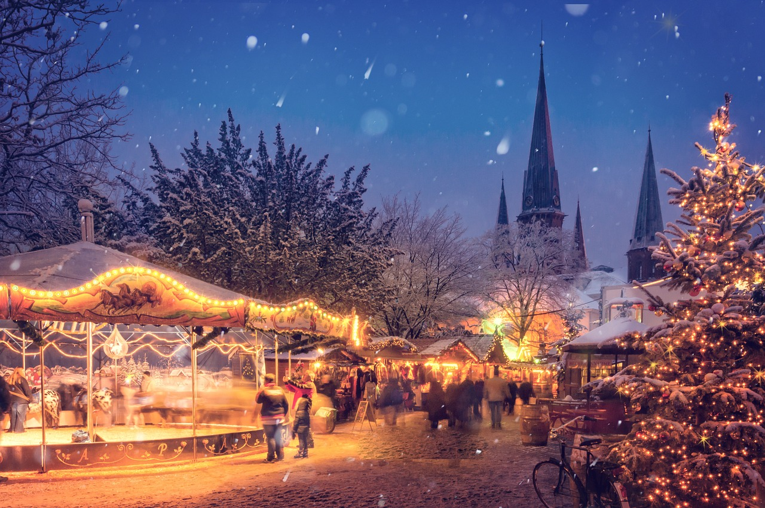
Gap fill: Be or Do
___ you afraid of travel alone? Why?
___ you like to travel with your mother? Why?
___ you prefer active or relaxing holidays? Why?
What ___ your favorite travel destination?
How ____ it keep a budget safe?
Are
Do
Do
is
does

Slide 10
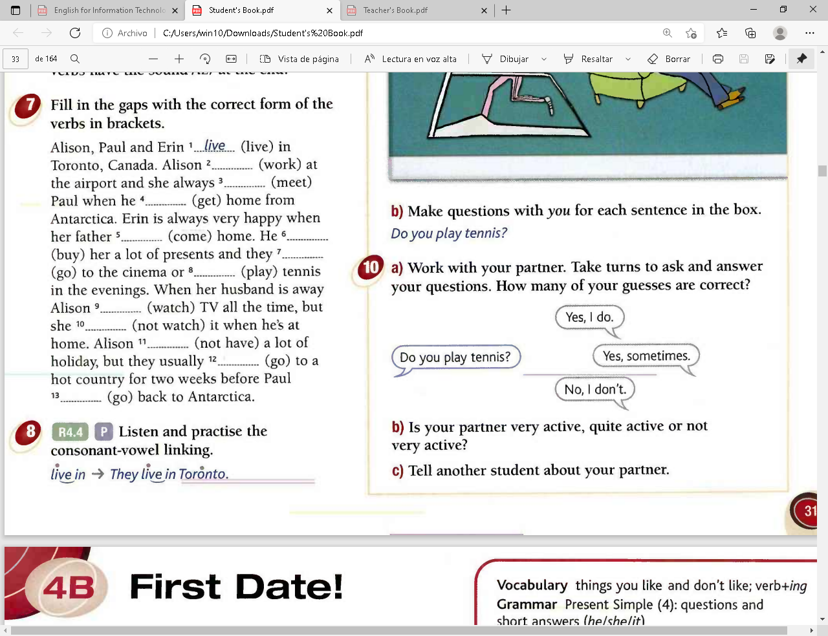
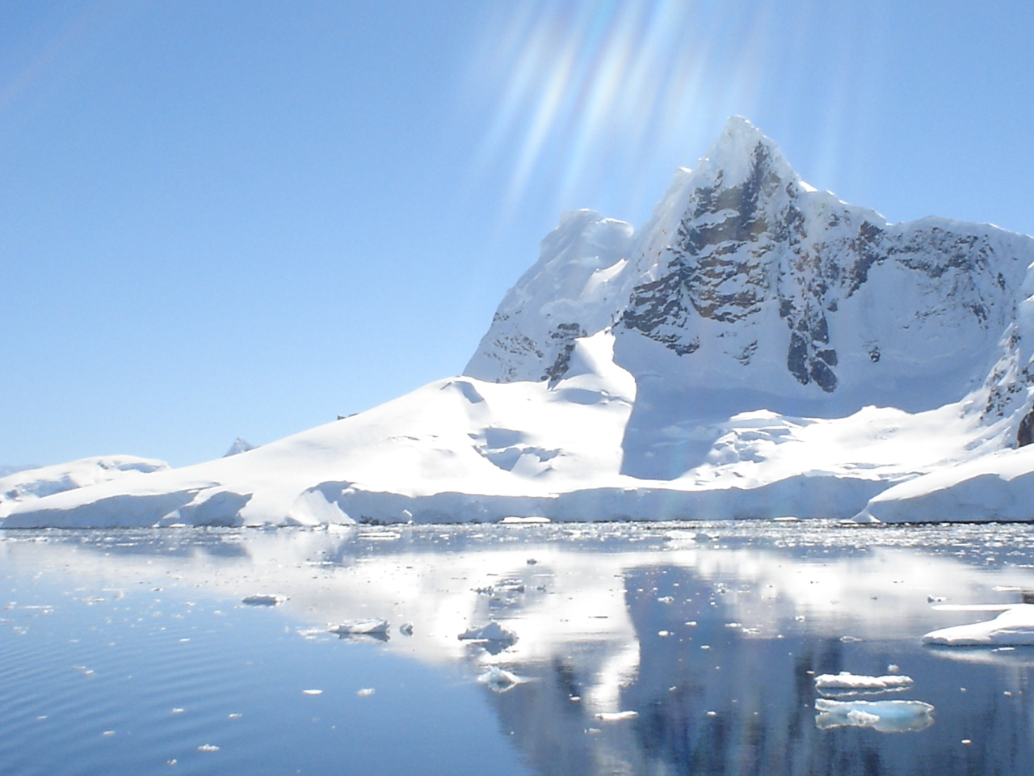
Away from home
works
meets
gets
comes
buys
go
play
watches
doesn’t watch
doesn’t have
go
goes
Retrieved from face2face student’s book, elementary. 2011

Slide 11
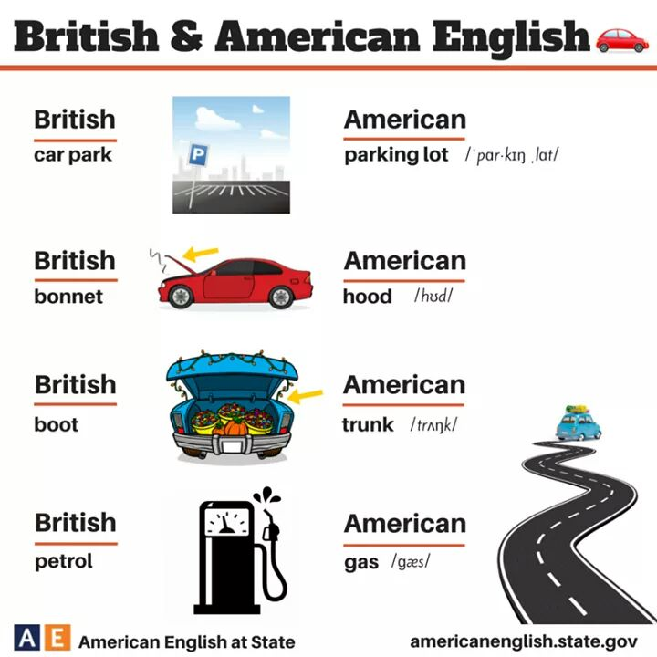
Transportation

Slide 12
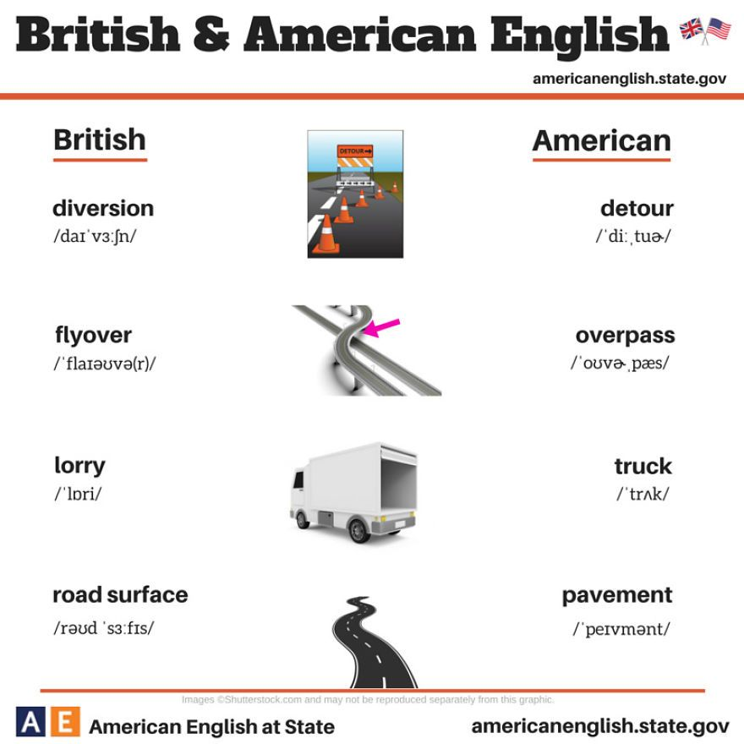
Transportation

Slide 13

Travel conversation

Slide 14
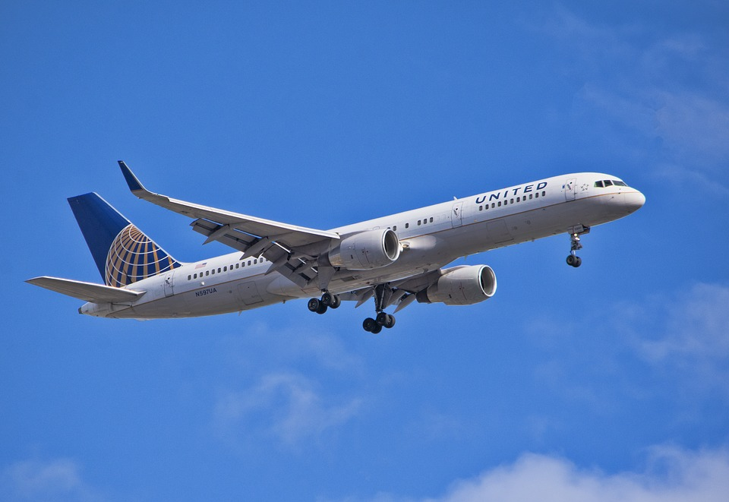
Travel conversation
Two
Receptionist: Yes, can I help you?
Tourist: Hi, my wife and I would like to check-in.
Receptionist: Could I have your name?
Tourist: Smith. S-M-I-T-H. John Smith.
One
Agent: Hello, Happy-Go-Lucky travel services.
Customer: Hello, I’d like to book a flight to Hawaii, please.
Agent: For how many passengers?
Customer: Two. For my wife and me.

Slide 15
Likes /Dislikes
a?
c?
d?
e?
b?
Match the words to the pictures.
I love…
I quite like…
I like…
I don’t like…
I hate…

Slide 16
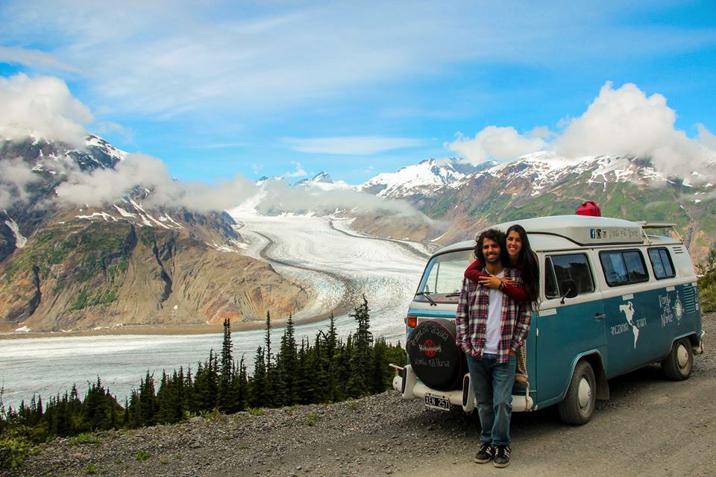
Discussion
In the morning, I like…
Everyday, I love…
On Sundays, I hate…
When I am travelling, I quite like…
I don’t like to travel light because…

Slide 17
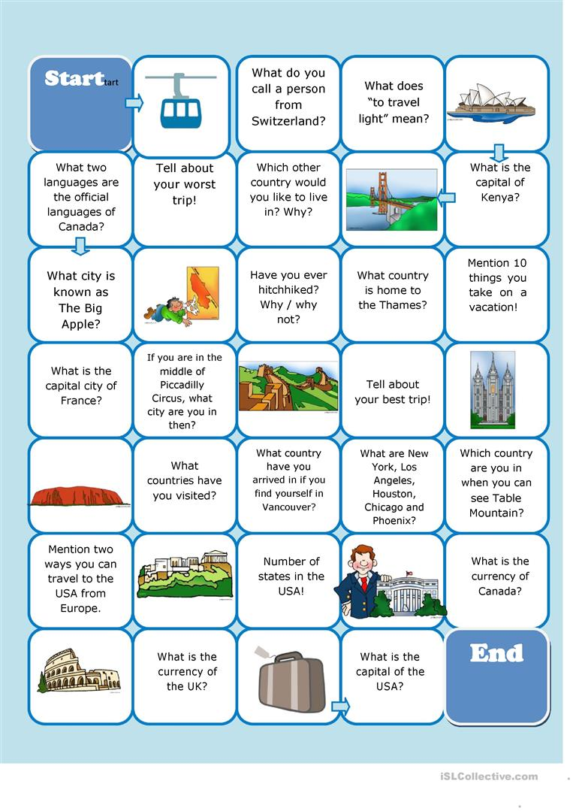

Travel board game

Slide 18
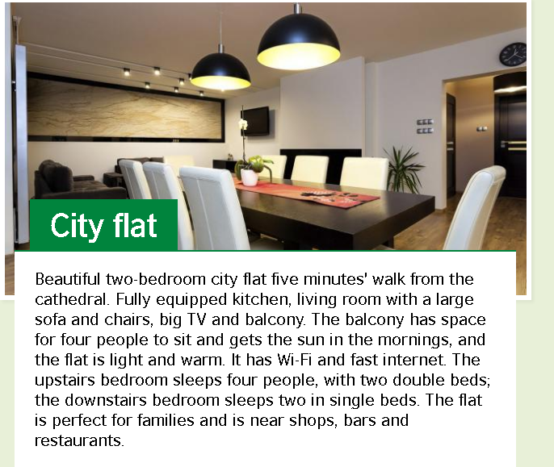
Holiday home adverts
How long is from the cathedral?
Has it got a balcony?
Is a cold flat?
How many bedrooms are there?
Are there any pubs around the city flat?
5 minutes
Yes
No
Two
Yes
Retrieved from: https://learnenglish.britishcouncil.org/skills/reading/beginner-a1/holiday-home-adverts

Slide 19
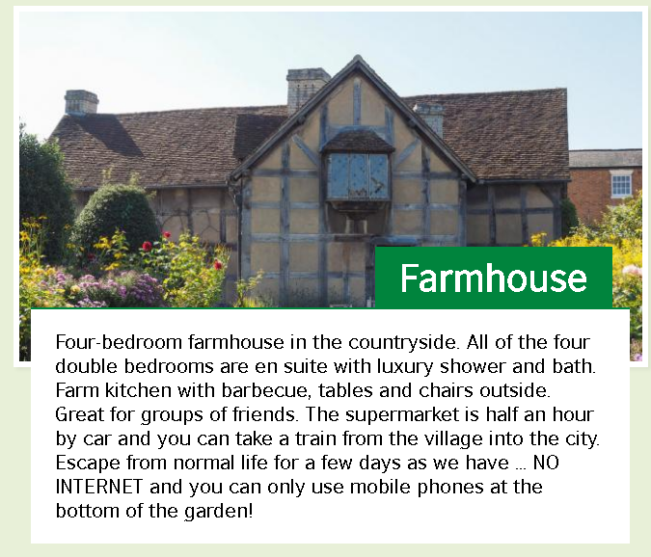
Holiday home adverts II
How many bathrooms are there?
How far is the supermarket?
Is there any Wi-Fi connection?
What can you use at the garden?
Where’s the farmhouse?
Four
30 minutes
No
Mobile phones
In the Countryside

Slide 20

Listening
Vocabulary
Amigos Ingleses
Games to learn English
English tips

Slide 21


